Slide 1


Slide 2

Project Objective
To help Amazon understand how customers perceive its products, and how reviews, ratings, and discounts influence purchasing decisions. The ultimate goal: drive smarter marketing, inventory, and pricing strategies.

Slide 3
Data Analysis Process
Data cleaning & formatting:
Cleaned missing values, formatted ratings & discounts
Data Transformation & Analysis:
Created sentiment labels, flags, and patterns using Pandas
Data Visualization (Dashboarding):
Built Power BI dashboard to present insights visually

Slide 4

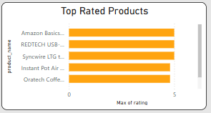
Top Rated Products
Products with consistent 4.8–5 star ratings across categories.
Impact: Ideal for featuring in marketing campaigns, suggested listings, and homepage highlights.

Slide 5
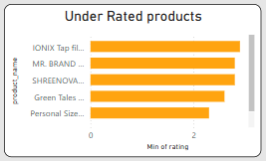
Low Rated Products
Products with less than 2.5 stars.
Impact: Risk to reputation and returns. Need investigation, review management, or removal

Slide 6
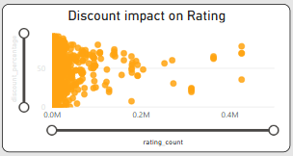
Discount vs Ratings
No strong correlation between discounts and higher ratings.
Impact: Discounts alone don’t build loyalty. Quality and fit matter more.

Slide 7
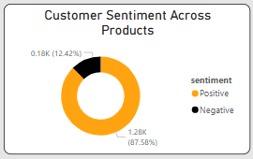
Sentiment Analysis
87% of reviews were positive. Negative sentiment clustered in a few categories.
Impact: Overall strong brand equity, with opportunity for focused improvement.

Slide 8
Skills Demonstrated
python (pandas, EDA, filtering)
Sentiment Analysis using NLP
Power BI (Dashboard, DAX)
Business Communication
Problem Solving

Slide 9
Conclusion & Suggestions
Conclusion:
I turned raw data into actionable business intelligence. This project shows I understand how to clean, analyze, and communicate insights that truly matter.
Business Suggestions:
1. Promote top-rated & hidden gem products to increase revenue.
2. Address pain points in low-rated and negative sentiment categories.
3. Shift marketing focus from discounts to long-term customer trust.
4. Use sentiment dashboards for monthly product performance review.

Slide 10


